Slide 1
ML.NET: новый .NET фреймворк для машинного обучения
Ольга Гавриш

Slide 2
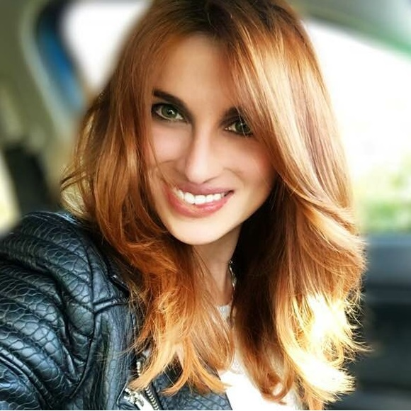
Olia Gavrysh
Program Manager, .NET team, Microsoft
twitter: @oliagavrysh
email: olia.gavrysh@microsoft.com
Notes:
This slide is required. Do NOT delete. This should be the first slide after your Title Slide.
This slide should describe what your goals are for this session. This information lets your audience know what you are trying to accomplish with your talk or tutorial—ie, what value will attendees get by investing 25 minutes or 2 hours of their time listening to you.
You should not spend more than 1 minute presenting this slide.
General examples of session goals could be (you will have to create your own specific goals):
Introduce a new technique or approach to solve a customer problem
Compare two approaches and explain why one is superior
Describe a project and the learnings that audience members can apply from it
Teach audience members how to use a specific technology

Slide 3
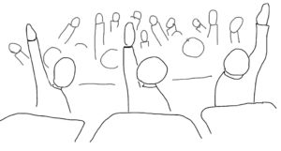
Сегодня мы поговорим
Что такое ML.NET
История создания
Планы и перспективы на будущее
Как узнать больше, как стать контрибьютером
Задавайте
вопросы!
Notes:
This slide is required. Do NOT delete. This should be the first slide after your Title Slide.
This slide should describe what your goals are for this session. This information lets your audience know what you are trying to accomplish with your talk or tutorial—ie, what value will attendees get by investing 25 minutes or 2 hours of their time listening to you.
You should not spend more than 1 minute presenting this slide.
General examples of session goals could be (you will have to create your own specific goals):
Introduce a new technique or approach to solve a customer problem
Compare two approaches and explain why one is superior
Describe a project and the learnings that audience members can apply from it
Teach audience members how to use a specific technology

Slide 4

Что такое ML.NET
Open source
repo: https://github.com/dotnet/machinelearning/
Cross-platform
Windows, Linux, MacOS
Framework
Общие структуры данных и шаблоны API
Возможность интеграции с TensorFlow, CNTK, Accord.NET, …
.NET
не нужно учить Python
не нужен клей-код
Notes:
This slide is required. Do NOT delete. This should be the first slide after your Title Slide.
This slide should describe what your goals are for this session. This information lets your audience know what you are trying to accomplish with your talk or tutorial—ie, what value will attendees get by investing 25 minutes or 2 hours of their time listening to you.
You should not spend more than 1 minute presenting this slide.
General examples of session goals could be (you will have to create your own specific goals):
Introduce a new technique or approach to solve a customer problem
Compare two approaches and explain why one is superior
Describe a project and the learnings that audience members can apply from it
Teach audience members how to use a specific technology

Slide 5
Отец ML.NET
∞
40+
Learners
80+
Transforms
Composability
To enable you to get world-class accuracy for your problem
To make data wrangling and featurizing easier
To allow flexible pipelines to ensemble, sweep, stack, featurize, etc
16M+
+140% YOY
Total Experiments
1.7K
+16% YOY
Active Users
49%
Internal Org Usage
(by CVP)
74%
Engineering Org Usage
(by CVP)
Notes:
This slide is required. Do NOT delete. This should be the first slide after your Title Slide.
This slide should describe what your goals are for this session. This information lets your audience know what you are trying to accomplish with your talk or tutorial—ie, what value will attendees get by investing 25 minutes or 2 hours of their time listening to you.
You should not spend more than 1 minute presenting this slide.
General examples of session goals could be (you will have to create your own specific goals):
Introduce a new technique or approach to solve a customer problem
Compare two approaches and explain why one is superior
Describe a project and the learnings that audience members can apply from it
Teach audience members how to use a specific technology

Slide 6
Roadmap
Image processing
Deep learning
Anomaly detection
Time Series
Интеграция с TensorFlow, CNTK, Accord.NET, …
...
Notes:
This slide is required. Do NOT delete. This should be the first slide after your Title Slide.
This slide should describe what your goals are for this session. This information lets your audience know what you are trying to accomplish with your talk or tutorial—ie, what value will attendees get by investing 25 minutes or 2 hours of their time listening to you.
You should not spend more than 1 minute presenting this slide.
General examples of session goals could be (you will have to create your own specific goals):
Introduce a new technique or approach to solve a customer problem
Compare two approaches and explain why one is superior
Describe a project and the learnings that audience members can apply from it
Teach audience members how to use a specific technology

Slide 7
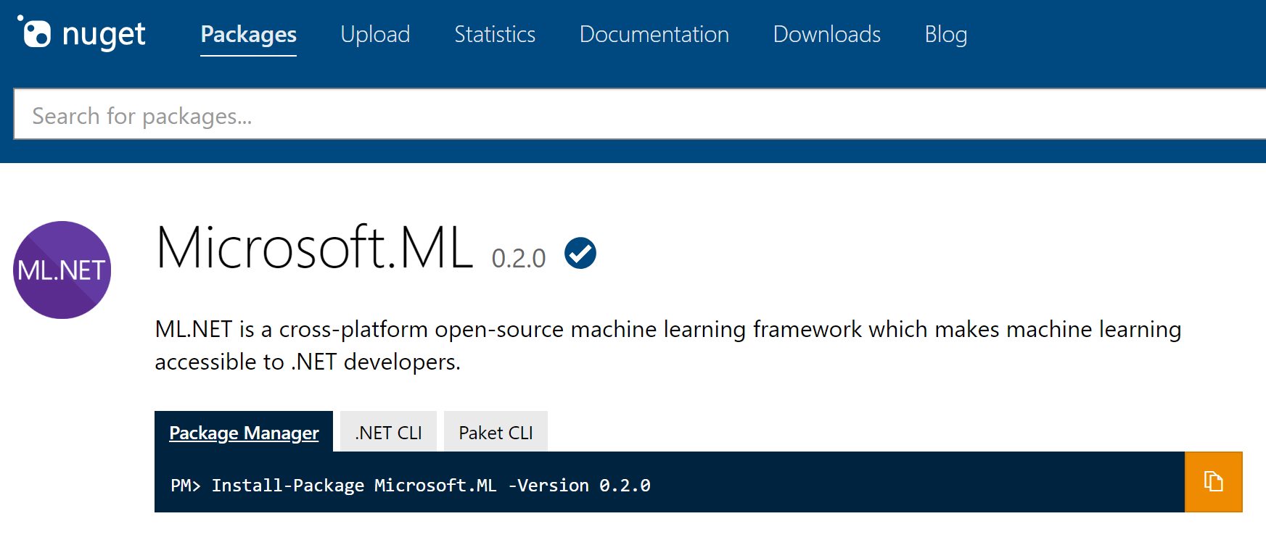
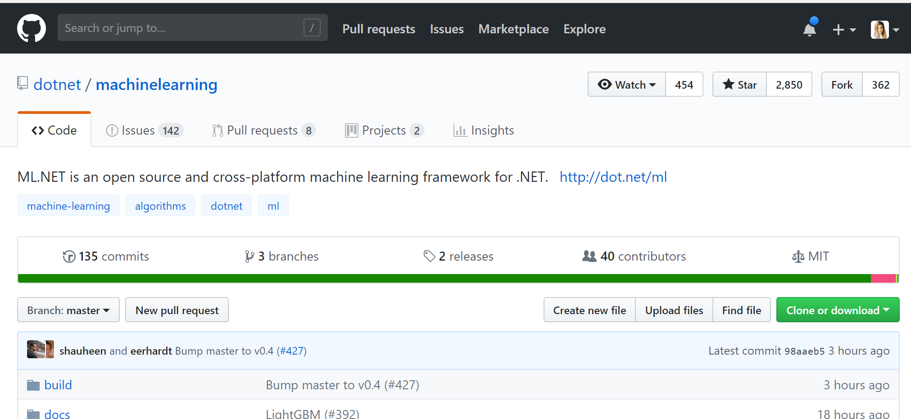
Как использовать ML.NET
NuGet pkg: Microsoft.ML
Fork on GitHub: https://github.com/dotnet/machinelearning/
Notes:
This slide is required. Do NOT delete. This should be the first slide after your Title Slide.
This slide should describe what your goals are for this session. This information lets your audience know what you are trying to accomplish with your talk or tutorial—ie, what value will attendees get by investing 25 minutes or 2 hours of their time listening to you.
You should not spend more than 1 minute presenting this slide.
General examples of session goals could be (you will have to create your own specific goals):
Introduce a new technique or approach to solve a customer problem
Compare two approaches and explain why one is superior
Describe a project and the learnings that audience members can apply from it
Teach audience members how to use a specific technology

Slide 8
Как узнать больше и стать контрибьютером
Примеры:
https://github.com/dotnet/machinelearning-samples
Документация:
https://docs.microsoft.com/en-us/dotnet/machine-learning/
Ваш вклад:
Создавайте баги
Фиксите баги
Добавляйте свои примеры
Дополняйте документацию
Пишите фичи
Notes:
This slide is required. Do NOT delete. This should be the first slide after your Title Slide.
This slide should describe what your goals are for this session. This information lets your audience know what you are trying to accomplish with your talk or tutorial—ie, what value will attendees get by investing 25 minutes or 2 hours of their time listening to you.
You should not spend more than 1 minute presenting this slide.
General examples of session goals could be (you will have to create your own specific goals):
Introduce a new technique or approach to solve a customer problem
Compare two approaches and explain why one is superior
Describe a project and the learnings that audience members can apply from it
Teach audience members how to use a specific technology

Slide 9
Вопросы

